Slide 1



ELON MUSK EMOTIONS OVER TIME (TWEETS NLP ANALYSIS)
Proyecto Final
A01535101
TC5031 Inteligencia Artificial

Slide 2
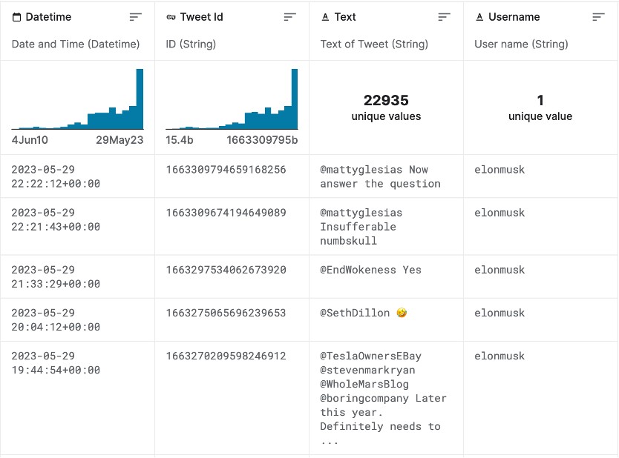
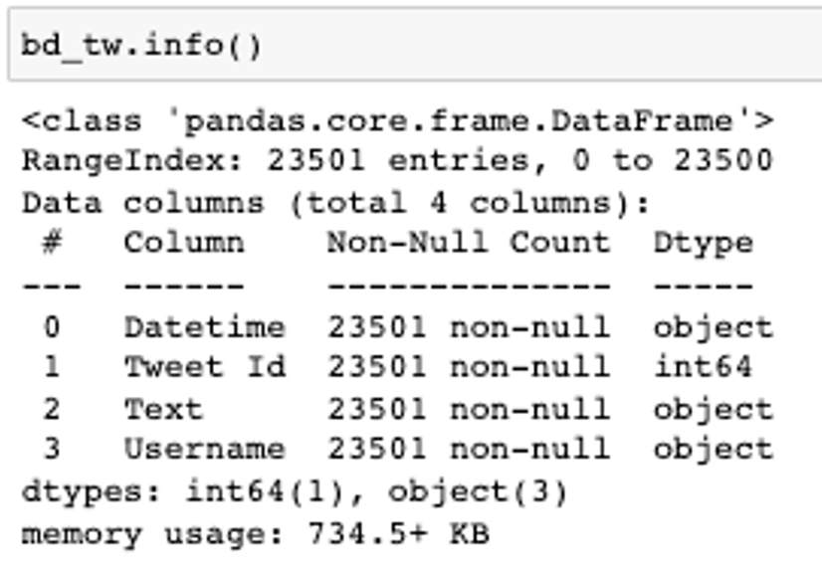
The data base

Slide 3
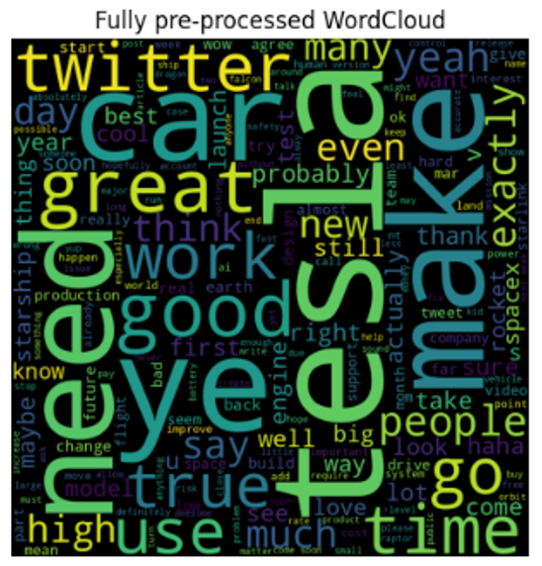
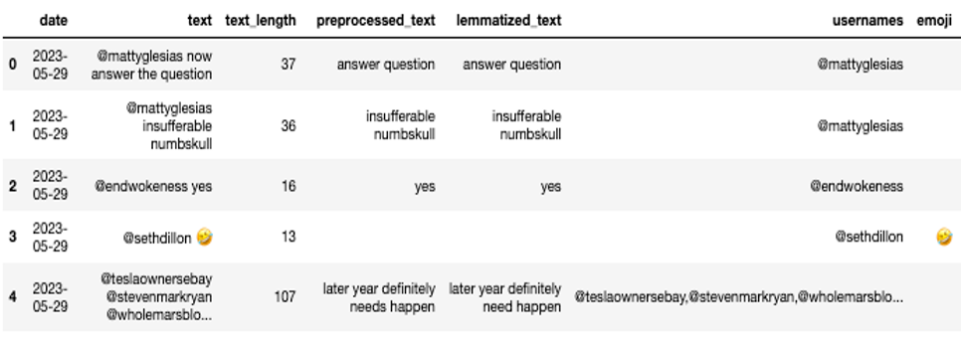
Procesamiento (Columnas de texto):
"Text":
-Lower_case
-Remove non-alphabetical
characters
-Extract Emojis
-Remove stop-words
-Tokenize
-Remove URL
-Extract @Usernames
"Text":
-Raw
-Emojis 🤣
-Non Alphabetical
-@Usernames
"text_lenght"
"preprocessed_text"
"usernames"
WordNetLemmatizer()
+ "event"
"lemmatized_text"

Slide 4
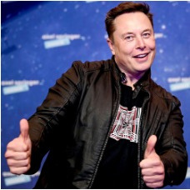
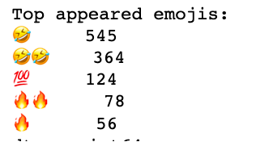
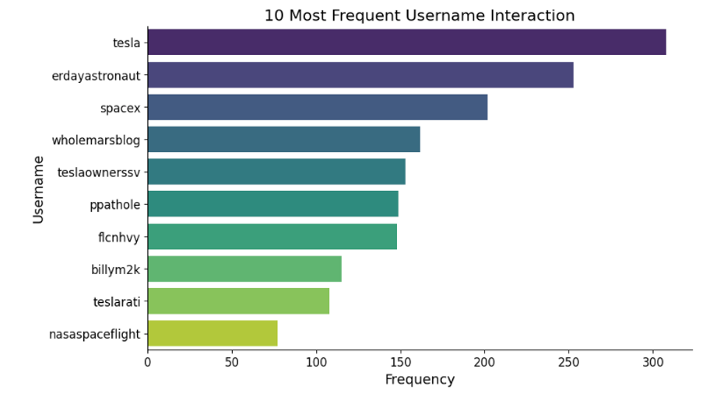
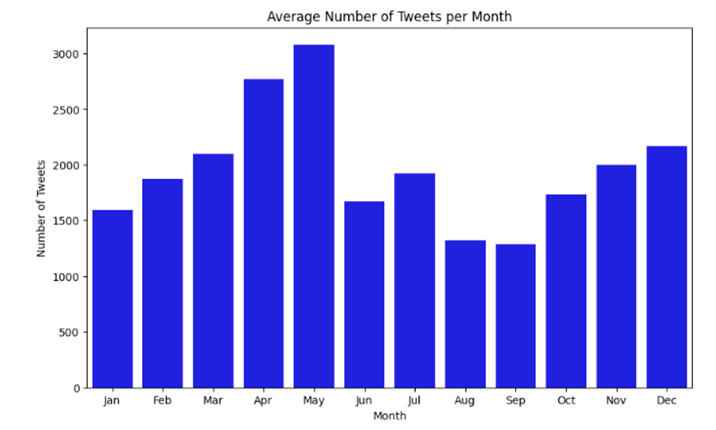
Exploratory Analysis:
-¿What months does he twit the most? On average Elon twits more in the months of May and April
-¿Who is the top usernames involved in Elons twits? @tesla (no suprises here)
-¿What are his most used emojis?

Slide 5
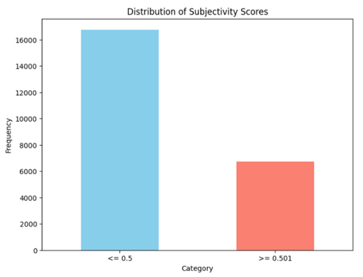
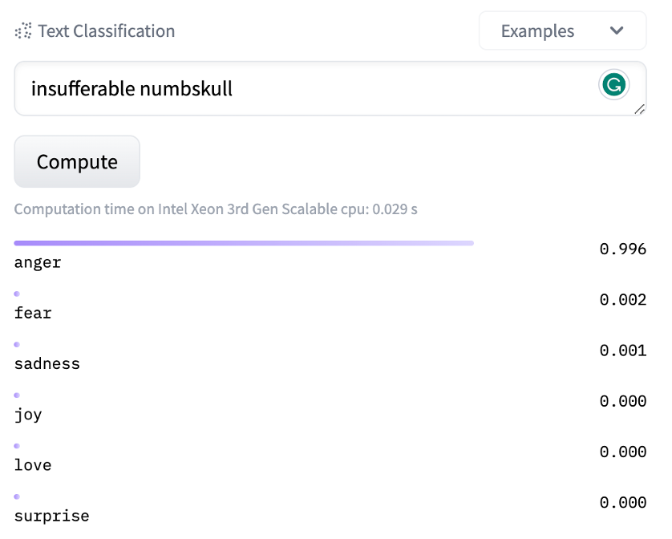
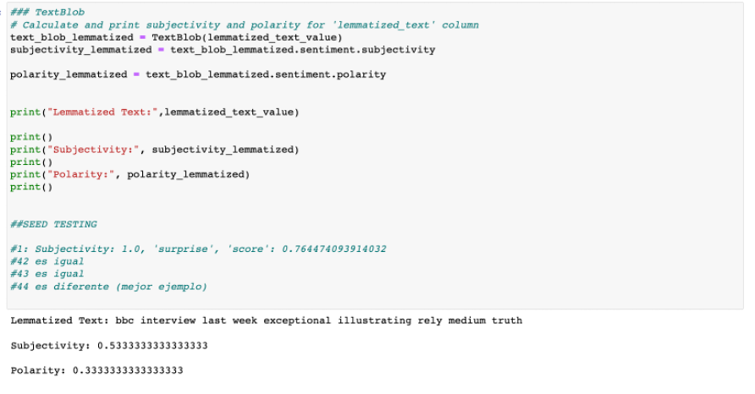
Model: Sentiment Analysis
1.TextBlop
2. Distilber-base-uncased-emotion

Slide 6
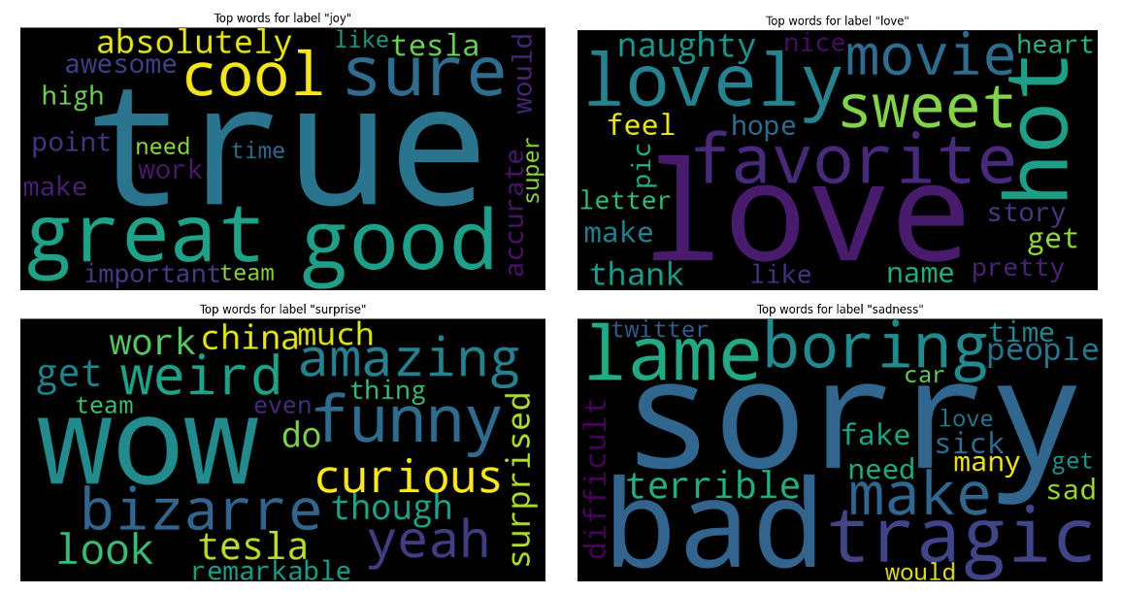
Model: TD-IDF Vectorizer

Slide 7
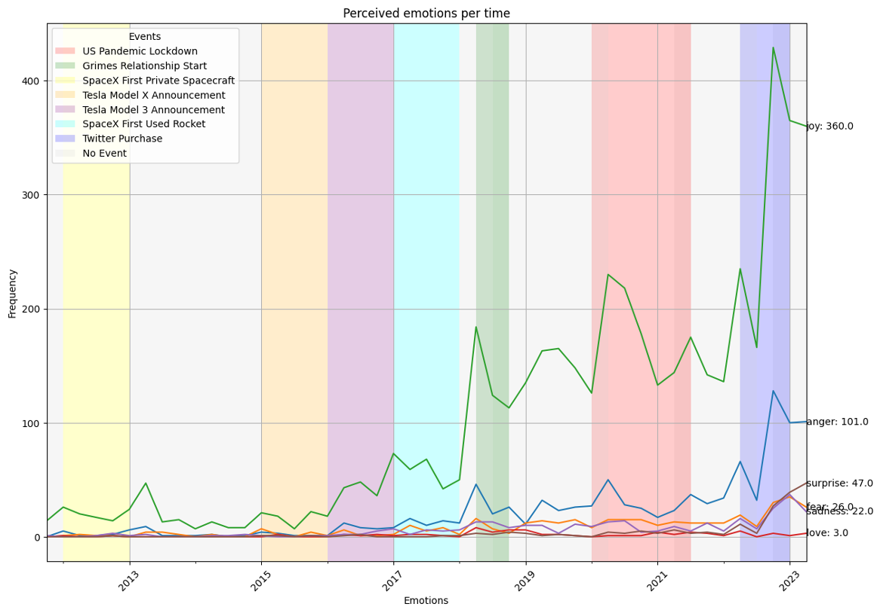
Findings
In this plot, we can observe that Elon's main perceived emotion in his tweets is joy. I think it's very interesting how the joy and anger lines exhibit notable patterns in specific situations.
For example, we can argue that his behavior tends to become a little nervous during important business announcements, or that he lost some joy at the beginning of his relationship with Grimes.

Slide 8
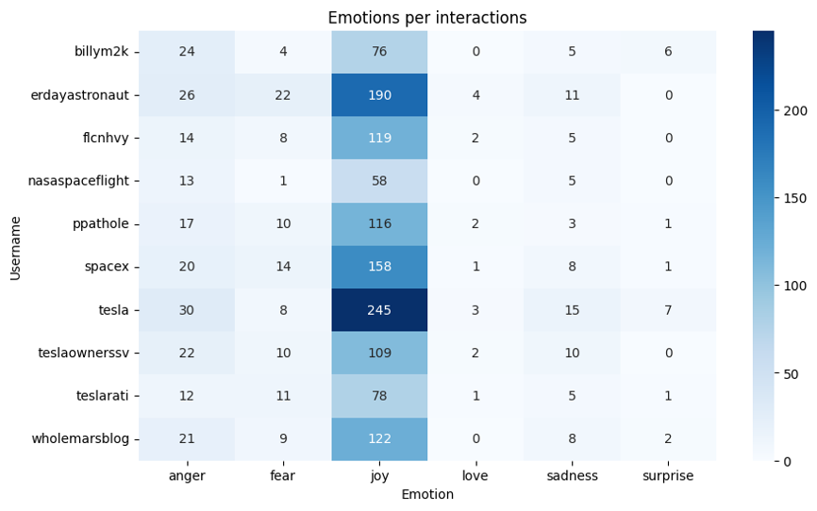
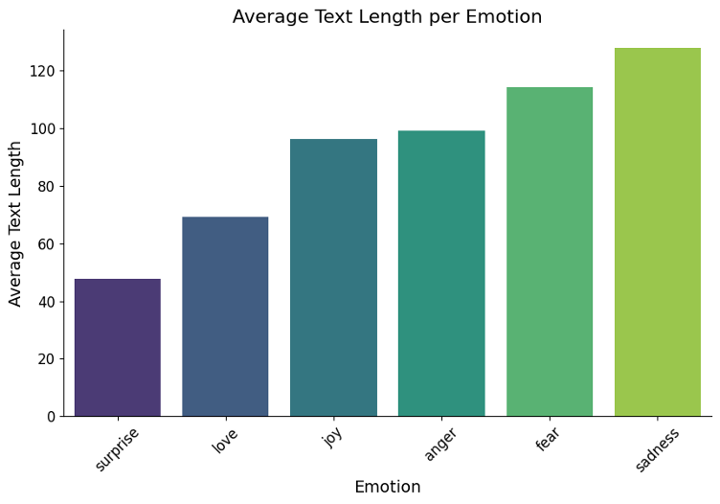
Findings
While most of the interactions seem to be quite positive,
it seems someone is running good marketing campaigns
Now, in this plot we can see how his tweets tend to get bigger for "negative" emotions, we can say that Elon feels confortable speaking his mind.

